Slide 1

CLUSTERING OF FLIGHT DATA
Suhaas SK
B.Tech CSE 2nd year
Under Prof. Manish Kumar Bajpai

Slide 2

The need to cluster flight data
The various flights needs to segmented into various clusters/ groups based on the similarity of its properties; like speed, direction vector and altitude. These clusters can be of various sizes.
This clustering of the various flights is necessary as we can study about the nature of the flights as a whole.
If we find a cluster of flights that is quite large, that could mean that these large of group of flights are travelling in the same trajectory, that could pose as a threat for that nation.
Radar updates flight data within 30min- 1hour. Thus we must be able cluster the flight data within that certain time limit
Notes:
Notes to presenter:
Description of what you learned in your own words on one side.
Include information about the topic
Details about the topic will also be helpful here.
Tell the story of your learning experience. Just like a story there should always be a beginning, middle and an end.
On the other side, you can add a graphic that provides evidence of what you learned.
Feel free to use more than one slide to reflect upon your process. It also helps to add some video of your process.

Slide 3
Problem with clustering data
Clustering is an unsupervised task, that means the data is not clustered based on any sort of target value, it is clustered purely based on the nature of the various parameters
K-means is the best, most flexible and most fastest algorithm that can be applied in this case.
The problem with k-means is that we have to specify one parameter. That parameter is the number of clusters by which data must be clustered by.
This is one of the biggest disadvantages of k-means, as finding a suitable value for this parameter is a difficult task.
Notes:
Notes to presenter:
Description of what you learned in your own words on one side.
Include information about the topic
Details about the topic will also be helpful here.
Tell the story of your learning experience. Just like a story there should always be a beginning, middle and an end.
On the other side, you can add a graphic that provides evidence of what you learned.
Feel free to use more than one slide to reflect upon your process. It also helps to add some video of your process.

Slide 4
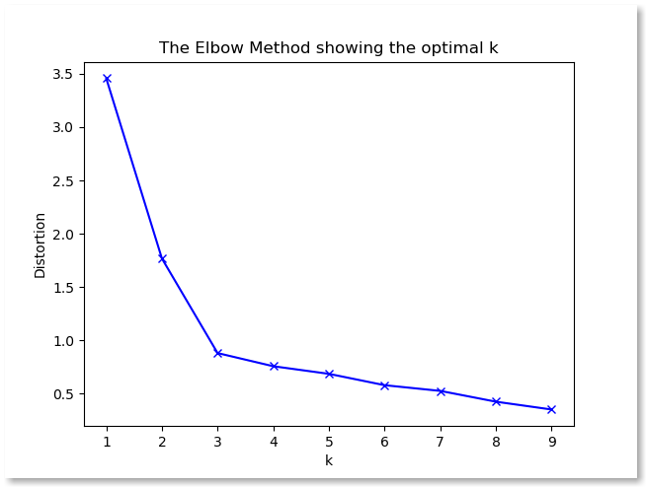
Elbow method to find optimal number of clusters
The only way to find the efficient number of clusters for a clustering algorithm is by running the clustering algorithms for various k-values (i.e number of clusters)
One of the earliest attempts to solve this was a visual technique called ‘elbow method’
Distortion is the average of euclidean distances from each point to its respective cluster centre
Here 3 would be optimal k-value, as this where the slope of the chart reduces, i.e the breaking point or elbow point
Disadvantage of this approach is that it is a purely visual approach
Notes:
Notes to presenter:
Description of what you learned in your own words on one side.
Include information about the topic
Details about the topic will also be helpful here.
Tell the story of your learning experience. Just like a story there should always be a beginning, middle and an end.
On the other side, you can add a graphic that provides evidence of what you learned.
Feel free to use more than one slide to reflect upon your process. It also helps to add some video of your process.

Slide 5
Silhouette score
Silhouette score established the relationship between the intra-cluster distance and the inter-cluster distance
Intra-cluster distance: Average distance of a data point from the points of the same cluster, let this be ‘a’
Inter-cluster distance: Average distance of a data point from the points of the closest cluster(for which the data doesn’t belong to) let this be ‘b’
Silhouette score for a data point= (b-a)/ max(a,b)
This quantity ranges from -1 to 1, being close to 1 signifies really good clusters (i.e. similar data points are clustered close together, whereas the other data points are clustered in a similar fashion but further away). Negative -1 signifies very poor clustering, 0 is average clustering
Notes:
Notes to presenter:
Description of what you learned in your own words on one side.
Include information about the topic
Details about the topic will also be helpful here.
Tell the story of your learning experience. Just like a story there should always be a beginning, middle and an end.
On the other side, you can add a graphic that provides evidence of what you learned.
Feel free to use more than one slide to reflect upon your process. It also helps to add some video of your process.

Slide 6
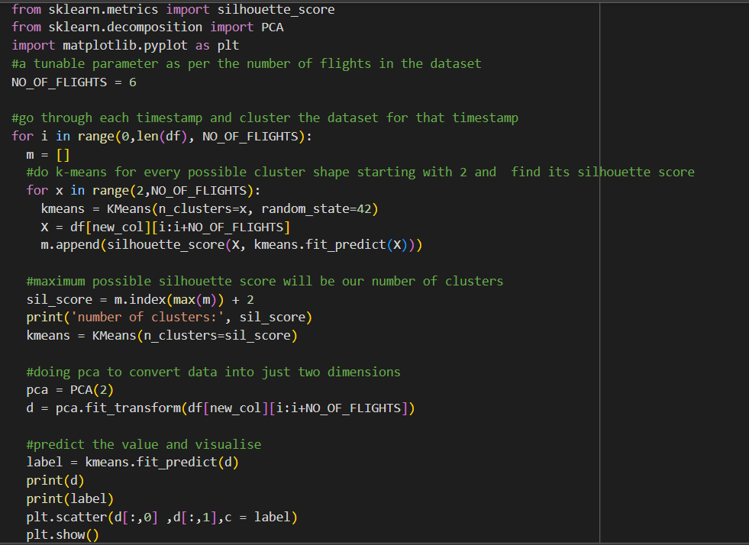
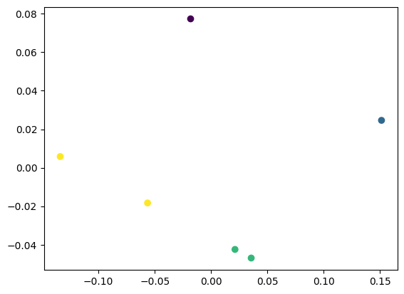
Silhouette score code
Visualing dataset in 2d through PCA, colours signifying clusters
Notes:
Notes to presenter:
Description of what you learned in your own words on one side.
Include information about the topic
Details about the topic will also be helpful here.
Tell the story of your learning experience. Just like a story there should always be a beginning, middle and an end.
On the other side, you can add a graphic that provides evidence of what you learned.
Feel free to use more than one slide to reflect upon your process. It also helps to add some video of your process.

Slide 7
Information-theoretic approach
This technique is quite a fast and efficient approach to solve various real-world problems
This also based distortion quantity. The average distortion/inertia calculated raised to the exponent of a constant -Y. Y is generally equal p/2, where p is the dimensionality of the dataset.
Once the distortions ^-Y are calculated for each k-value and we store them in a array. Then we calculate the jump. The jump is difference between two subsequent distortion^-Y values in the array.
Once we calculate the jumps we find out the k-value for which there is the maximum jump. That k-value will the optimal k
Notes:
Notes to presenter:
Description of what you learned in your own words on one side.
Include information about the topic
Details about the topic will also be helpful here.
Tell the story of your learning experience. Just like a story there should always be a beginning, middle and an end.
On the other side, you can add a graphic that provides evidence of what you learned.
Feel free to use more than one slide to reflect upon your process. It also helps to add some video of your process.

Slide 8
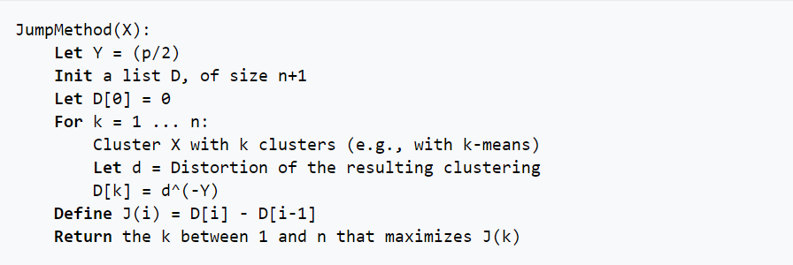
Information-theoretic approach - Algorithm
Notes:
Notes to presenter:
Description of what you learned in your own words on one side.
Include information about the topic
Details about the topic will also be helpful here.
Tell the story of your learning experience. Just like a story there should always be a beginning, middle and an end.
On the other side, you can add a graphic that provides evidence of what you learned.
Feel free to use more than one slide to reflect upon your process. It also helps to add some video of your process.

Slide 9
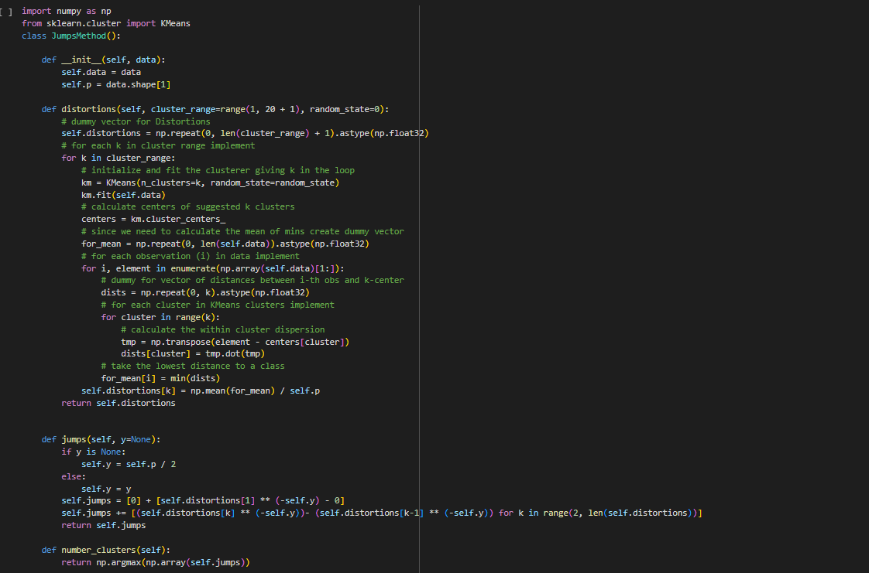
Information-theoretic approach - Algorithm
Notes:
Notes to presenter:
Description of what you learned in your own words on one side.
Include information about the topic
Details about the topic will also be helpful here.
Tell the story of your learning experience. Just like a story there should always be a beginning, middle and an end.
On the other side, you can add a graphic that provides evidence of what you learned.
Feel free to use more than one slide to reflect upon your process. It also helps to add some video of your process.

Slide 10
Data Wrangling
Data wrangling is necessary for passing data into various ML models
Data wrangling here involves feature engineering (dropping out less important features, creating new features)
Stardardisation also should be done as the various columns have different ranges. Features with smaller ranges will be given less priority in comparison with features with larger ranges.
This is because k-means is purely Euclidean based, larger values result in larger distances in the geometric space. So we must standardize the columns such that they all lie within a certain range.
Once data is cleaned (numericalised) we can pass it to any AI model
Notes:
Notes to presenter:
Description of what you learned in your own words on one side.
Include information about the topic
Details about the topic will also be helpful here.
Tell the story of your learning experience. Just like a story there should always be a beginning, middle and an end.
On the other side, you can add a graphic that provides evidence of what you learned.
Feel free to use more than one slide to reflect upon your process. It also helps to add some video of your process.

Slide 11
Feature Engineering
We mainly focus on eight columns in the dataset. Namely, the timestamp, track number, longititude, latitude, x-position, y-position, speed and altitude
We cluster each timestamp of the dataset, so the data must be filtered for each stamp each time clustering is done. More than x and y position we can get more useful information out of the direction vector
The direction vector can be considered as the angle between the North face (+ve y-axis) and the direction vector of the flight. This is just (pi/2 – tan-1(y/x))
Once we calculate the direction angle, we can drop x,y columns, as this direction angle gives us more value
Notes:
Notes to presenter:
Description of what you learned in your own words on one side.
Include information about the topic
Details about the topic will also be helpful here.
Tell the story of your learning experience. Just like a story there should always be a beginning, middle and an end.
On the other side, you can add a graphic that provides evidence of what you learned.
Feel free to use more than one slide to reflect upon your process. It also helps to add some video of your process.

Slide 12
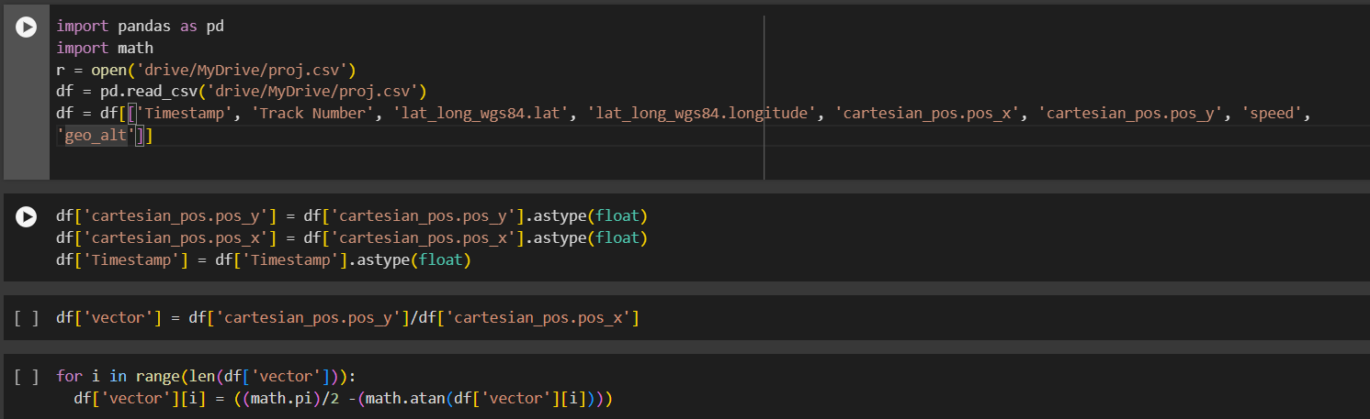
Feature Engineering
Notes:
Notes to presenter:
Description of what you learned in your own words on one side.
Include information about the topic
Details about the topic will also be helpful here.
Tell the story of your learning experience. Just like a story there should always be a beginning, middle and an end.
On the other side, you can add a graphic that provides evidence of what you learned.
Feel free to use more than one slide to reflect upon your process. It also helps to add some video of your process.

Slide 13
Standardisation
Standardisation of data is transforming the data in such a way that the limits of the data are well defined and in a way such that features with larger values and smaller values are given equal importances
One of the most common standardization techniques is finding min-max value, which does a good job and is the most frequently used technique for stardisation
But in this case I decided to standardizing by find the z-score.
Z-value(x) = (x-a)/b
Where a-mean of the column
b = standard deviation
Once z-score is applied for a certain feature, it’s mean will be one and standard deviation will be 0. These important statistical quantities will be fixed throughout the dataset
Notes:
Notes to presenter:
Description of what you learned in your own words on one side.
Include information about the topic
Details about the topic will also be helpful here.
Tell the story of your learning experience. Just like a story there should always be a beginning, middle and an end.
On the other side, you can add a graphic that provides evidence of what you learned.
Feel free to use more than one slide to reflect upon your process. It also helps to add some video of your process.

Slide 14
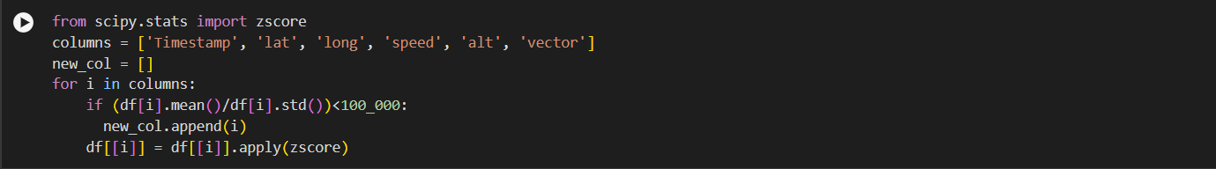
Standardisation
Notes:
Notes to presenter:
Description of what you learned in your own words on one side.
Include information about the topic
Details about the topic will also be helpful here.
Tell the story of your learning experience. Just like a story there should always be a beginning, middle and an end.
On the other side, you can add a graphic that provides evidence of what you learned.
Feel free to use more than one slide to reflect upon your process. It also helps to add some video of your process.

Slide 15
References
https://www.researchgate.net/publication/330821155_The_effect_of_Z-Score_standardization_normalization_on_binary_input_due_the_speed_of_learning_in_back-propagation_neural_network
https://www.researchgate.net/publication/329316112_The_Determination_of_Cluster_Number_at_k-Mean_Using_Elbow_Method_and_Purity_Evaluation_on_Headline_News
https://www.researchgate.net/publication/4746600_Finding_the_Number_of_Clusters_in_a_Dataset_An_Information-Theoretic_Approach
https://www.researchgate.net/publication/4772044_Estimating_the_Number_of_Clusters_in_a_Data_Set_Via_the_Gap_Statistic
Notes:
Notes to presenter:
Description of what you learned in your own words on one side.
Include information about the topic
Details about the topic will also be helpful here.
Tell the story of your learning experience. Just like a story there should always be a beginning, middle and an end.
On the other side, you can add a graphic that provides evidence of what you learned.
Feel free to use more than one slide to reflect upon your process. It also helps to add some video of your process.

